Slide 1
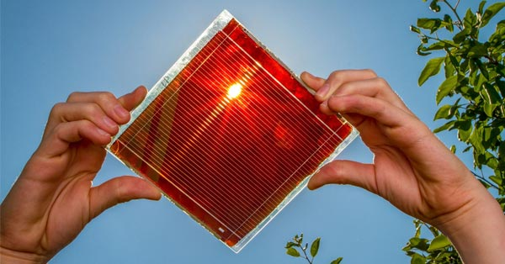
Perovskites
as an emerging solution on the solar market
Klaudia Gnyla
December 2022

Slide 2
Content
1 Solar energy market
2 PV market
3 PV generations
4 Introduction to perovskites
5 Pervoskite market
6 Key players
7 Recent breakthroughs
8 Funding rounds

Slide 3
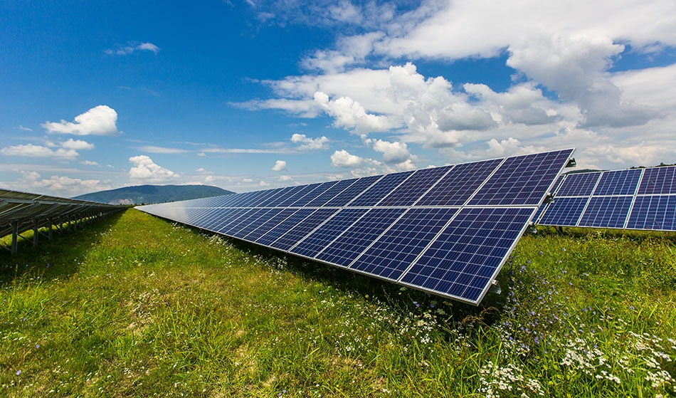
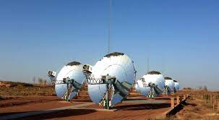
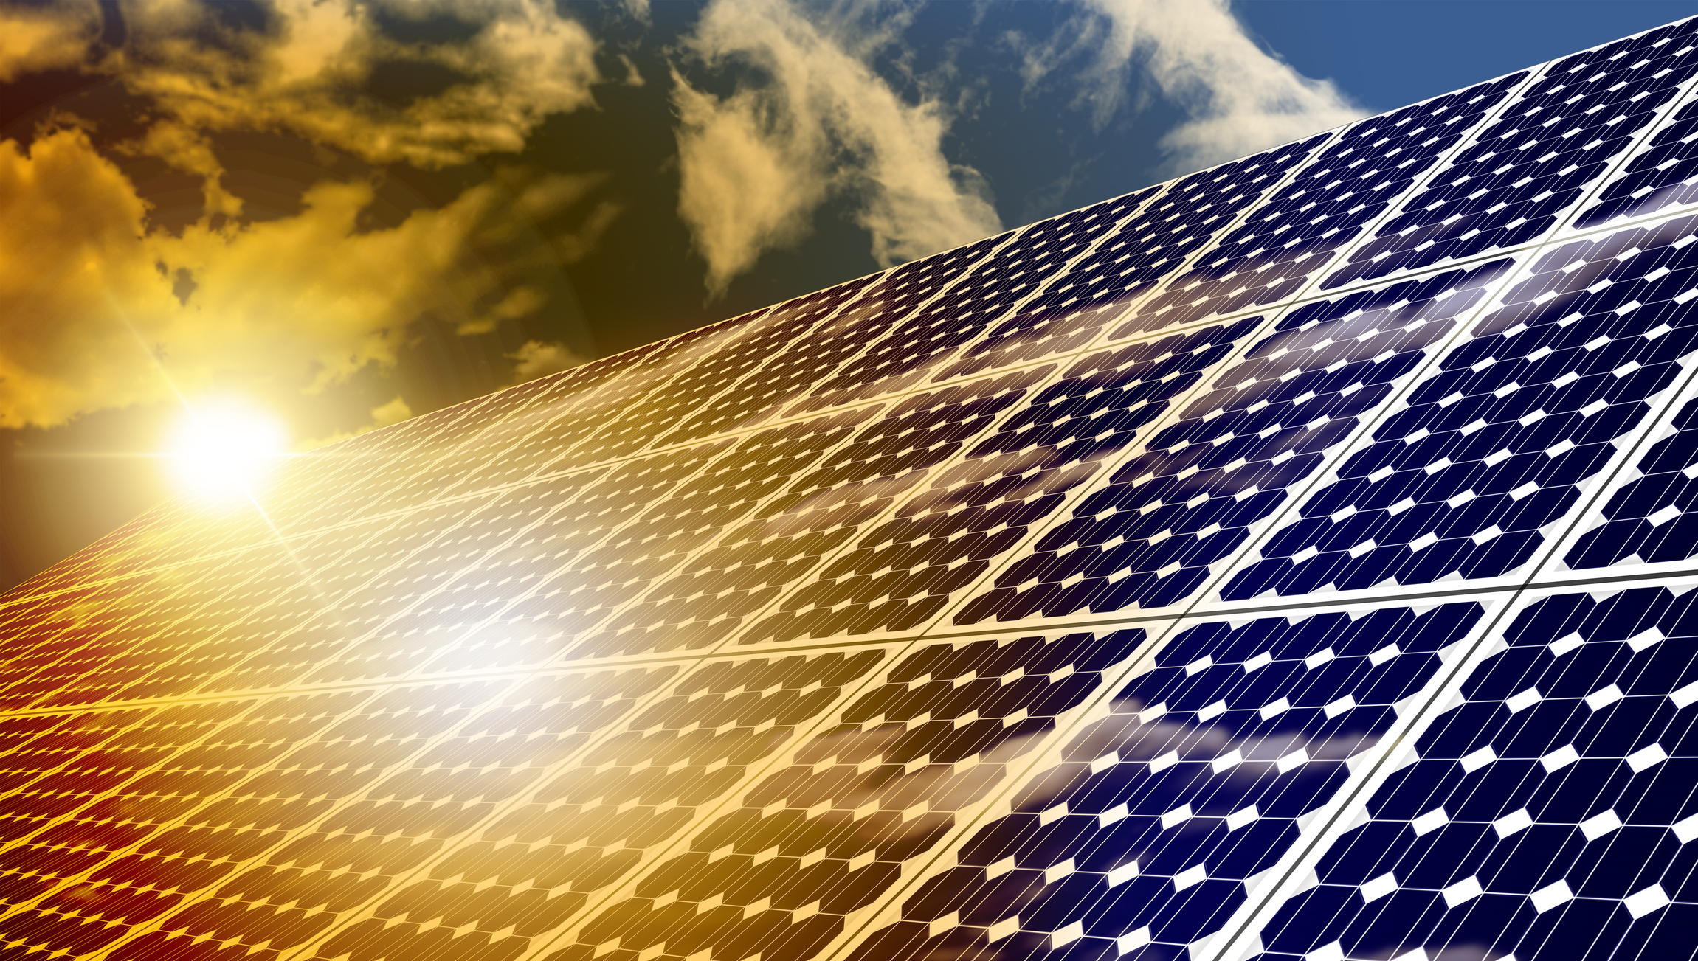
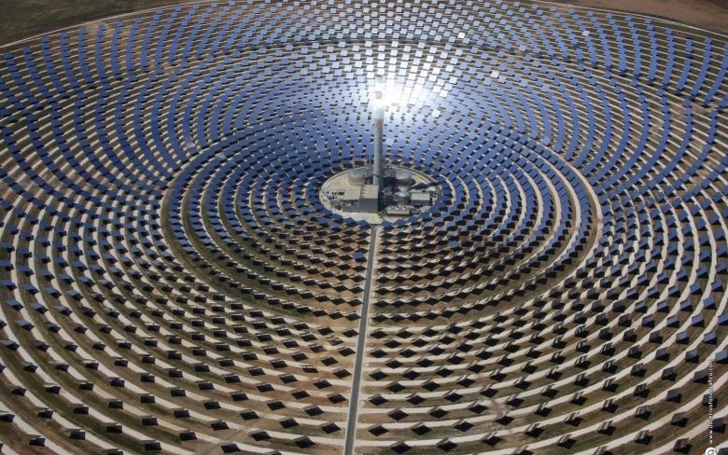
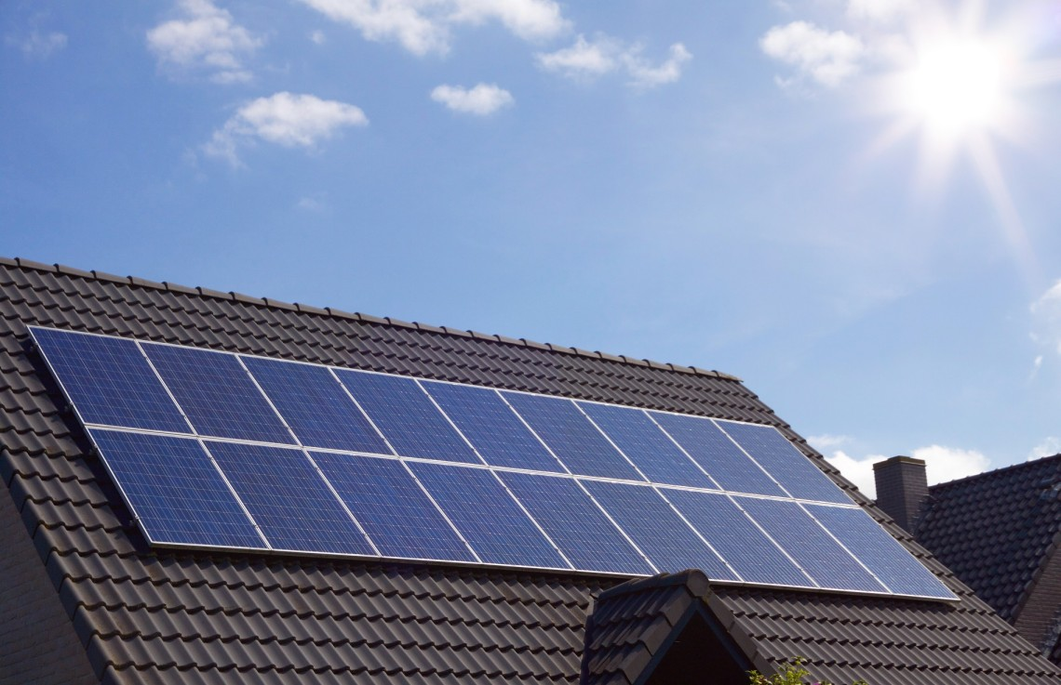
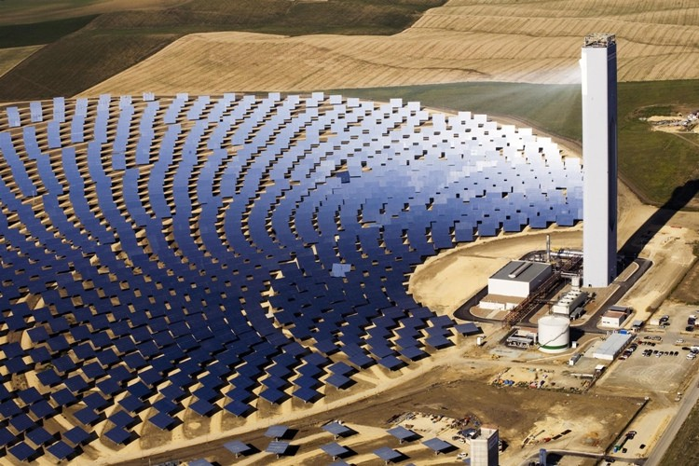
1 | Solar energy market
There are two ways to harness the energy from the Sun
PV
Photovoltaics
CSP
Concentrated Solar Power
Energy from photons
Energy from heat
Made up of Si (silicon)
Consist of mirrors/lenses and
usually a crystal in a middle
In 2021 valued at $161.15B
In 2021 valued at $4.71B
The forecast says that these numbers
will almost double by 2030
https://www.fortunebusinessinsights.com/industry-reports/solar-power-market-100764
https://www.globenewswire.com/

Slide 4
2 | PV market
The evolution of PV energy sector and its cost curve
Achieving PV energy generation of approx. 7500 TWh in 2030 aligns with the net zero scenerio in 2050.
Taking into account the current 1000 TWh energy generation, we need a growth of 25% each year between 2022 and 2030.
https://www.iea.org/reports/solar-pv

Slide 5
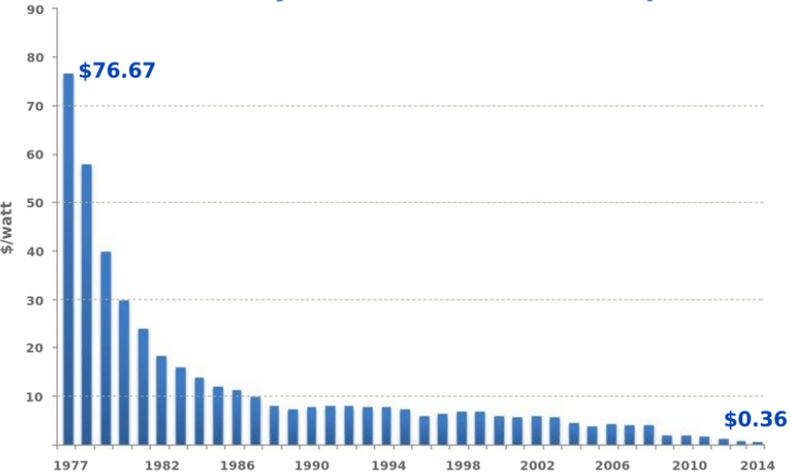
2 | PV market
Generation of energy from PV panels got much cheaper since it went commercial
PV panels became commercialized around 1960 at the price of $300/watt.
With time, the price was decreasing gradually to reach $0.18/watt in 2020 – it is almost 1700 times less than in 1960.
https://www.researchgate.net/figure/2-Evolution-of-the-energy-cost-in-dollars-per-watt-peaks-for-silicon-based-solar_fig4_329413496
https://www.everlightsolar.com/a-brief-history-of-solar-power-how-did-it-come-to-be/

Slide 6
2 | PV market
Among all countries, China is the leader on the market being resposible for 38% solar energy production
CHINA
Owns 5 out of 6 world‘s largest solar-module manufacturing companies
Produces 70% of world‘s silicon
Provide the cheapest solar panels (production powered by fossil fuels)
Invests in domestic and outbound renewable sources (in order to
fight water and air pollution which cause millions of deaths a year)
Until now EU has been investing in research on solar panels, there was not much funding for scaling up the technologies
In 2022 installes 41.4GW of new solar capacity – largest growth in EU‘s history
Initiatives as The European Green Deal and the REPowerEU which want to prioritize solar energy as a key solution in energy transition
European panels are more expensive but of higher quality
Decentralization of the market and locality of production
EUROPE
https://www.iea.org/reports/solar-pv
https://www.csis.org/east-green-chinas-global-leadership-renewable-energy
https://www.solarpowereurope.org/press-releases/new-market-report-2021-the-best-year-in-european-solar-history-2022-europe-set-to-hit-30-gw-installation-level https://www.euronews.com/green/2022/12/20/eu-solar-power-soars-by-almost-50-in-2022-which-country-installed-the-most
https://energy.ec.europa.eu/topics/renewable-energy/solar-energy_en

Slide 7
3 | PV generations
There are 3 generations of photovoltaics used currently
 | Silicon (1st generation) | Thin-film photovoltaics (CdTe) (2nd generation) | Perovskite (3rd generation)
Highest record efficiency | 25% | 25% | 29%
Lifespan | 25-30 yrs | 10-20 yrs | 2.5 yrs
Light spectrum | > 800 nm | 400-800 nm | < 800 nm
Cell thickness | 200-500 µm | 1 µm | 0.2-0.4 µm
Price per Watt | $0.16-0.46/W | $1-1.5/W | $0.16/W
One of the biggest obstacles of perovskite market
https://solarmagazine.com/solar-panels/perovskite-solar-cells/
https://www.energy.gov/eere/solar/perovskite-solar-cells https://www.nature.com/articles/s41598-022-13418-4
https://newatlas.com/energy/perovskite-silicon-solar-cells-30-percent-effic

Slide 8
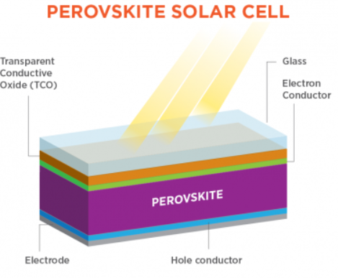
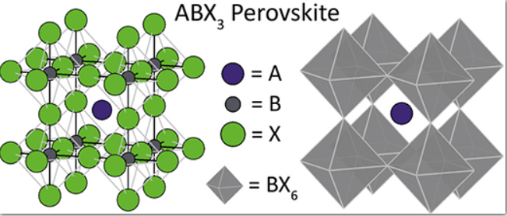
4 | Introduction to perovskites
Perovskites form a family of crystals of a specific spatial structure
The first discovered perovskite was the
calcium titanium oxide CaTiO₃
The working principles of perovskite cells are the same
as for stadard Si cells
ABX₃
A – organic cation
B – metal ion
X -halide ion
One of the most abundant crystal structure on Earth, 38% of the Earth‘s mass consists of perovskites
https://www.nanowerk.com/what-are-perovskites.php

Slide 9
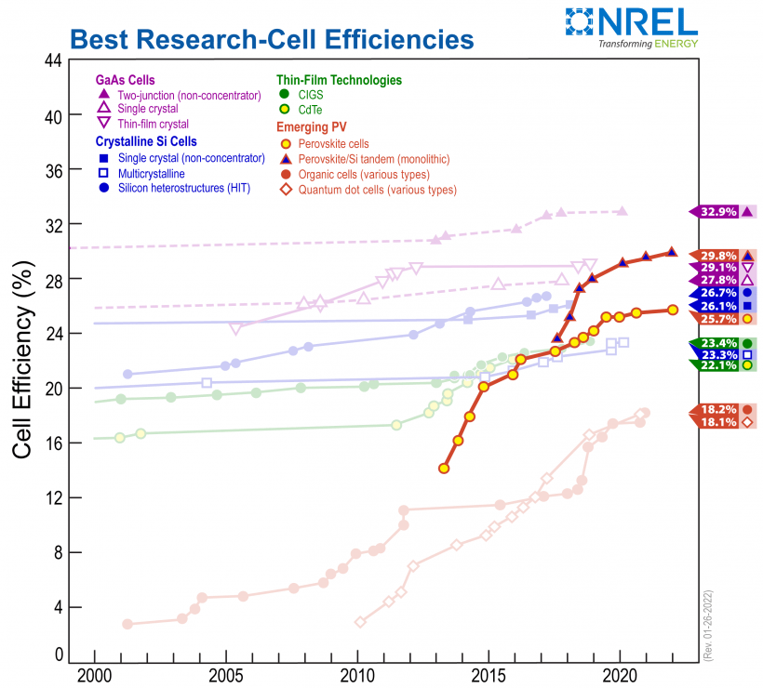
5 | Perovskite market
Perovskite cell efficiency experience a much more rapid growth than other solutions
There are few more aspect that make perovskites a promising solution on the PV market:
Great tolerance to defects – Si panels require extremely high purity while perovsites have good conversion factors even with imperfections
Lesser sensitivity to the angle at which the light falls on
Production requires much less amounts of energy compared to Si panels – it makes perovskite cells cheaper
Flexibility (56% of the perovskite market)
Translucent
Great performance in the artificial light
Nevertheless, there is still space for improvement:
Lifespan
Pb (lead) toxicity
Current-voltage hysteresis
https://www.nrel.gov/pv/cell-efficiency.html

Slide 10
5 | Perovskite market
The perovskite market is still small, but it is prognosed to grow 10x until 2030
Perovskite market is young - there is no
company producing at mass-scale
The main focus of the perovskite market are now
tandem cells. However, there are some
companies going commercial with ‚pure‘
perovskite solar cells
As for the whole PV market, China is also
considered the leader
However, when it comes to EU perovskite market,
we have the strongest R&D, many companies
specializing in perovskites and vicinity to the
minerals in Switzerland, Italy and Sweden
CAGR 31.8% from 2022 to 2030
https://www.researchnester.com/reports/perovskite-solar-cells-market/513

Slide 11
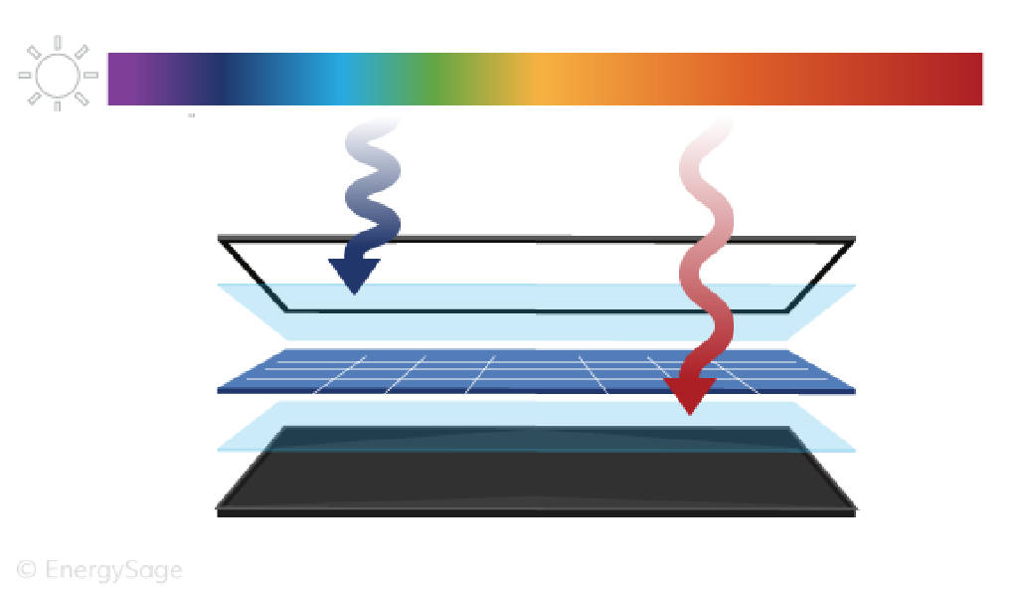
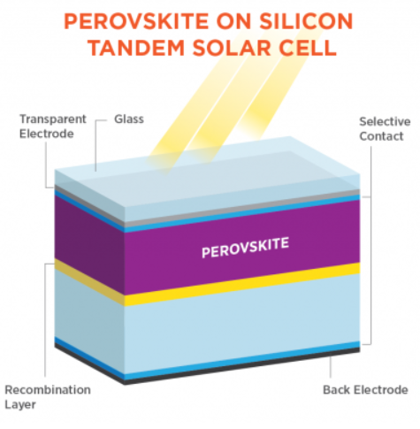
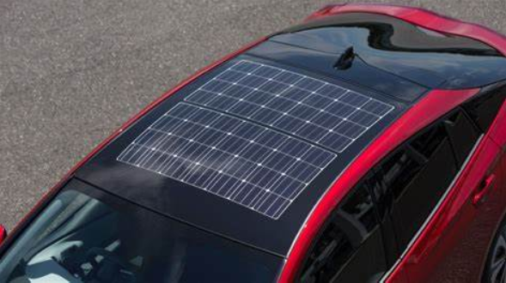
5 | Perovskite market
There are two interesting solutions on the perovskite cell market - perovskite-Si tandem cells and perovskites for IoT solution
Perovskites and Si address different parts of light spectrum
Flexibility of perovskite panels, their good peroformance in artificial light* and lightness introduce new ways of solar panels usage – in-house and on-cars
Price tags
Panels on walls inside buildings
Phone/backpack chargers
On-car panels
A perovskite-Si tandem cell is simply a sandwich of a silicon panel and a perovskite panel on top of it
The record efficiency for such panels is 31.25%
The Ulsan National Institute of Science and Technology started collaboration with Hyundai in order to develop perovskite-silicon tandem cells and apply them to solar roofs
https://www.energy.gov/eere/solar/perovskite-solar-cells
http://www.businesskorea.co.kr/news/articleView.html?idxno=95728
https://www.ajudaily.com/view/20220610170241279

Slide 12

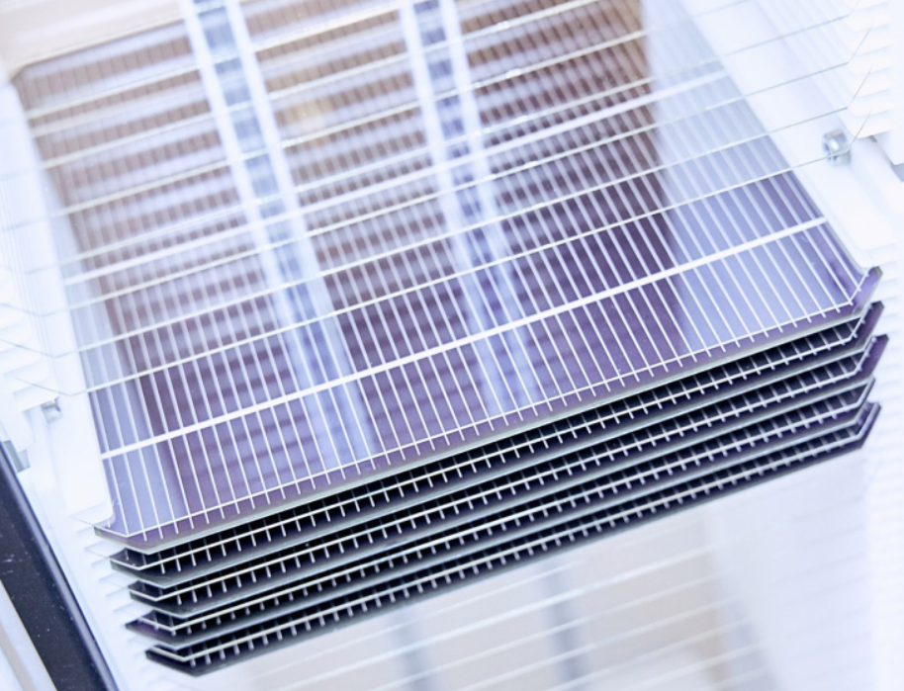
6 | Key players
Oxford Photovoltaics focuses on silicon-perovskite tandem cells
Their main focus are silicon-perovskite tandem cells
R&D department is placed in Oxford, the factory in Brandenburg an der Havel
They achieved 29.52% efficiency (2020)
for the tandem cell which was the world record
for any solar cell back then. However, they predict to sell cells with 27% efficiency (24% energy yield)
Opening the production line in 2023
FUNDING
In total - $141.9M for 10 rounds, the last one was raised in July 2019
from Series D round of 65M pounds (Goldwind, Equinor, Legal & General Capital, Meyer Burger Technology)
https://www.oxfordpv.com/
https://www.reuters.com/business/energy/perovskite-solar-goes-commercial-yield-gains-align-with-market-forces-2023-02-02/

Slide 13

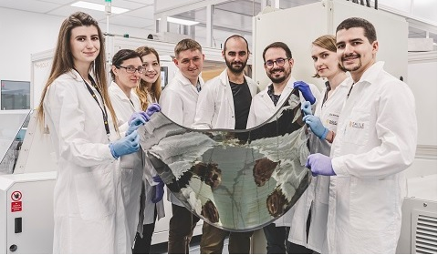
6 | Key players
Saule Technologies is one of the key players on the perovskite market
The CTO‘s work was a catalyst for the explosive growth in perovskite research
First in the world perovskite industrial line
They produce perovskite panels by the
ink-jet printing perovskite onto the PET foil
25.5% efficiency for IoT applications, 31% efficiency
for indoor cells and 10% efficiency in one sun (AM1.5G)
First in the world perovskite industrial line
https://sauletech.com/

Slide 14
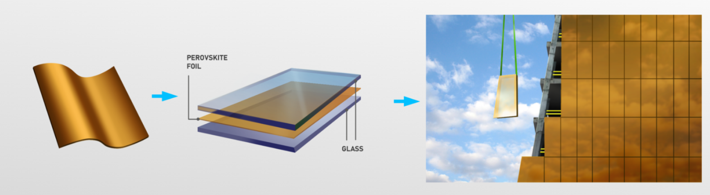
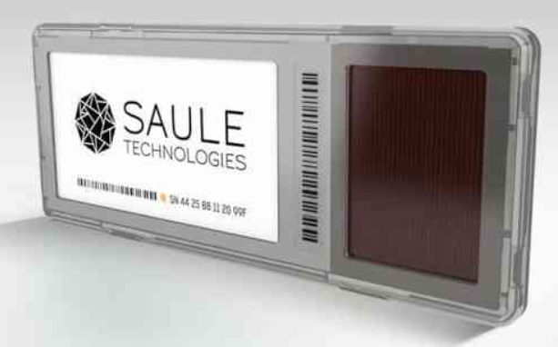

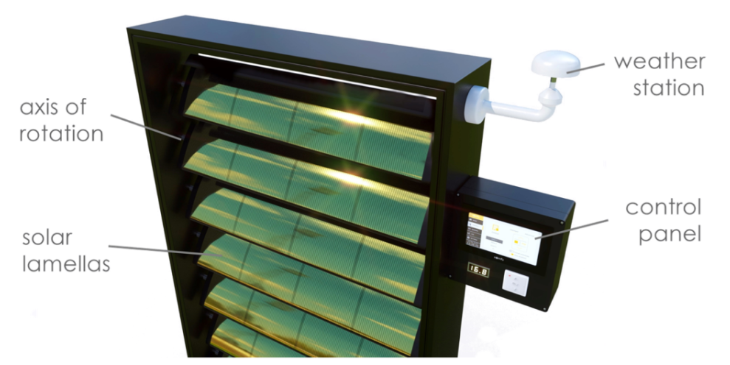
6 | Key players
Saule Technology focuses on IoT products now, their solutions base on transparent perovskite cells
In September 2020 they received €10M
from Columbus Energy
Went public without IPO through a reverse merger
of a shell company Blumerang Investors (May 2022)
Now, together with Google Cloud and
Columbus Energy working on IoT solutions
https://sauletech.com/

Slide 15

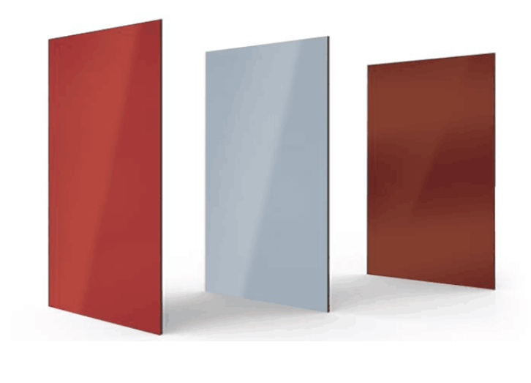

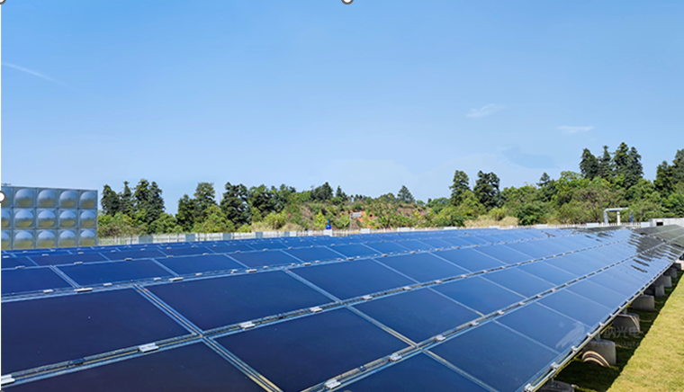
6 | Key players
Microquanta Semiconductor produce ‘pure’ perovskite cells
Chinese company manufacturing perovskite panels of 17% electricity conversion
Have raised $10M in total funding (last funding - Series D) and plan to
commercialize the technology and find production lines this year
They passed IEC stability test which demonstrated a lifetime of 25 years
https://www.forbes.com/profile/microquanta/?sh=7c9e715639af
http://www.microquanta.com/en/solution/

Slide 16
7 | Recent breakthroughs
Efficiency was boosted to 25.5%.
MIT researchers added a specially treated conductive layer of tin dioxide bonded to the perovskite material, which improved the path for charge carriers
in the cell. To achieve that they also modified the perovskite formula.
(https://news.mit.edu/2021/photovoltaic-efficiency-solar-0224)
New record for tandem cell efficiency
CSEM and EPFL achieved 31.25% efficiency. ‚They achieved an efficiency of 30.93% for a 1 cm² solar cell based on high-quality perovskite layers from
solution on a planarized silicon surface and an efficiency of 31.25% on a cell of the same size and fabricated with a hybrid vapor/solution processing
Technique compatible with a textured silicon surface.‘
(https://www.pv-magazine.com/2022/07/07/csem-epfl-achieve-31-25-efficiency-for-tandem-perovskite-silicon-solar-cell/)
New record for tandem cell efficiency
Princeton Engineering researchers have developed the first perovskite solar cell with a commercially viable lifetime – around 30yrs.
(https://www.princeton.edu/news/2022/06/29/once-seen-fleeting-new-solar-tech-proves-its-lasting-power)
Pb leakage prevention
They showed that Pb leakage may be prevented by a built-in resin layers. They ‚reported a new device structure that incorporates a low-cost
mesoporous sulfonic acid-based lead-adsorbing resin into perovskites as a scaffold, which immobilizes lead ions inside the scaffold even if perovskites
are exposed to rainwater. Introducing the insulating scaffold not only does not decrease the device efficiency, but also can be scaled up to large-area
modules (60.8 cm²) with an aperture efficiency of 16.3%‘.
(https://www.nature.com/articles/s41893-021-00701-x)

Slide 17






8 | Funding rounds
Good Growth Capital,
Climate Capital,
Safar Partners
First Solar,
Bill Gates-owned BEV
Horizon Europe
(EU funding programme)
Columbus Energy
Bioeconomy Capital
July 2019 – Oxford PV closed 65M Series D round
September 2020 – Saule Technologies received €10M
End of 2020 – Swift Solar closed a seed round of $8M. They specialize in tandem cells, perovskites for cars and lightweight aerial machines
June 2021 – 1366 Technologies and Hunt Perovskite merge into CubicPV, secure $25M in funding
April 2022 – Tandem PV raises $6M in Series A
June 2022 – the U.S. Department invested $900k in 3 perovskite projects (high-speed printing, defect testing and investigation of new protective layers for pervoskite panels)
November 2022 – Qcells and a research group from Helmholtz-Zentrum Berlin establish a pilot manufacturing line for Si-perovskite tandem cells, secured $14.9M
https://www.perovskite-info.com/doe-awards-funding-3-perovskite-related-pv-projects
https://pv-magazine-usa.com/2022/11/23/qcells-european-consortium-launch-production-line-for-tandem-silicon-perovskite-solar-cells/
https://www.pv-magazine.com/2021/06/28/1366-technologies-merges-with-hunt-perovskite-technologies/

Slide 18
9 | Summary
Conclusions
Perovskites are a great implementation to the already-existing solar panel technologies. With them we can boost the cell‘s efficiencies and increase the amount of energy obtained from the Sun. This will help us in achieving the solar energy generation goals for 2030.
After my research I concluded that Si-perovskite tandem cells are the main focus of companies dealing with perovskites right now. It will be crucial when key players, like Oxford PV, finally launch their production lines and how the customers/market respond to it.
Moreover, perovskites open a totally new branch of solar cell usage – the in-house solutions. It will finally enable implementation of such solar cells on cars and curvy areas which, with standard Si cells, was not possible.
Nevertheless, certain development on durability and toxicity has to be done. As we have seen, there are already solutions mitigating these problems.
https://www.iea.org/reports/solar-pv

